Slide 1
Experiments
경상국립대학교 수학과 석사과정 오서영

Slide 2
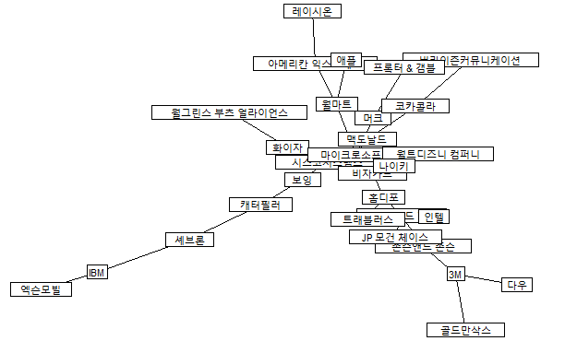
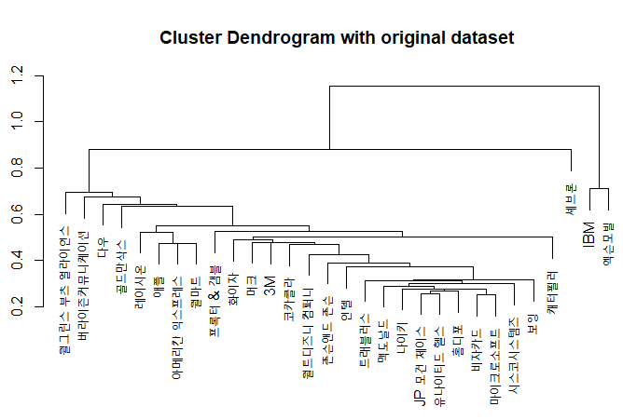
Experiments 1
Euclidean distance, MST
Hierarchical_clustering.R
1. Original dataset

Slide 3
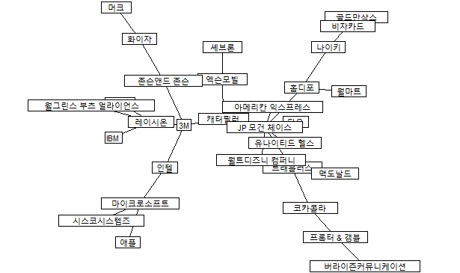
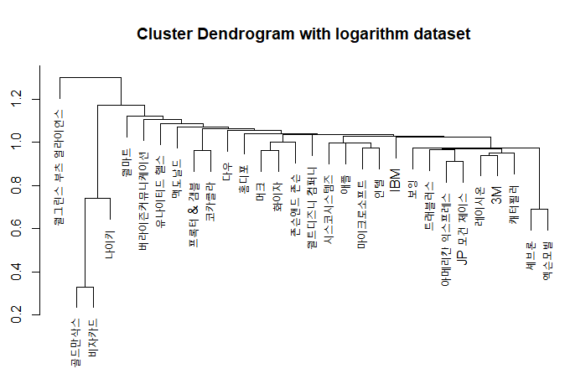
Experiments 1
Euclidean distance, MST
Hierarchical_clustering.R
2. Logarithm dataset $(Y=ln(P\left(t\right))−ln\left(P\left(t−1\right)\right))$

Slide 4
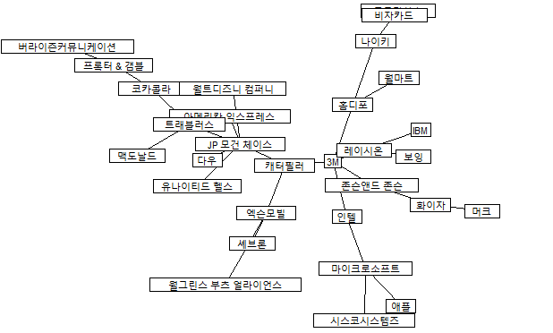
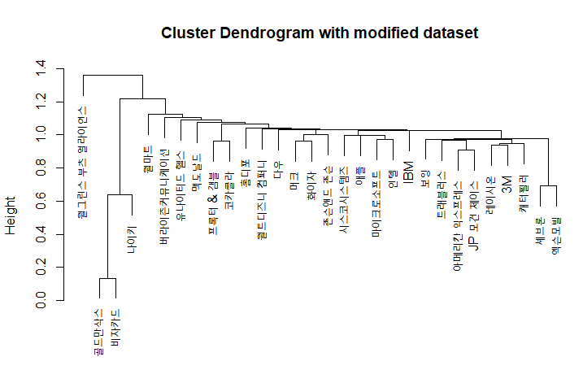
Experiments 1
Euclidean distance, MST
Hierarchical_clustering.R
3. Rate of change dataset $(Y=\frac{P\left(t\right)−P\left(t−1\right)}{P\left(t−1\right)})$

Slide 5
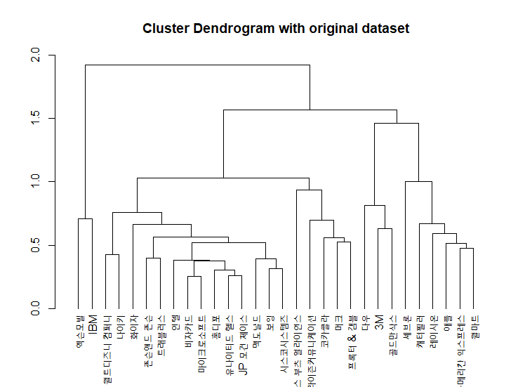
Experiments 2
Subdominant ultrametric hierarchical tree
Hierarchical_clustering.R
1. Original dataset

Slide 6
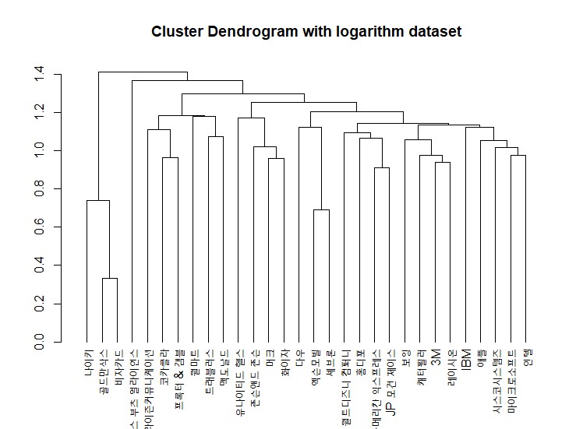
Experiments 2
Subdominant ultrametric hierarchical tree
Hierarchical_clustering.R
2. Logarithm dataset $(Y=ln(P\left(t\right))−ln\left(P\left(t−1\right)\right))$

Slide 7
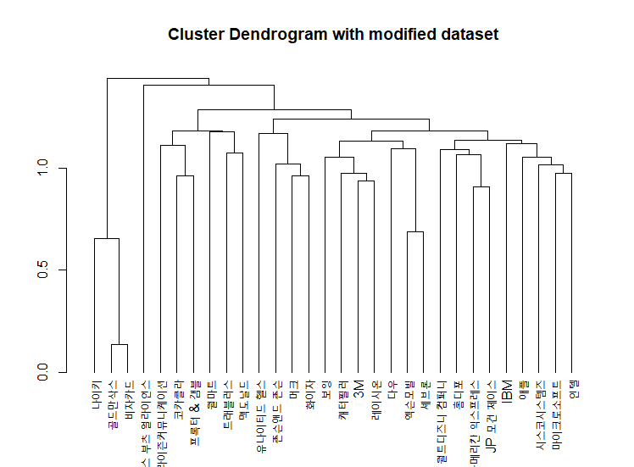
Experiments 2
Subdominant ultrametric hierarchical tree
Hierarchical_clustering.R
3. Rate of change dataset $(Y=\frac{P\left(t\right)−P\left(t−1\right)}{P\left(t−1\right)})$

Slide 8
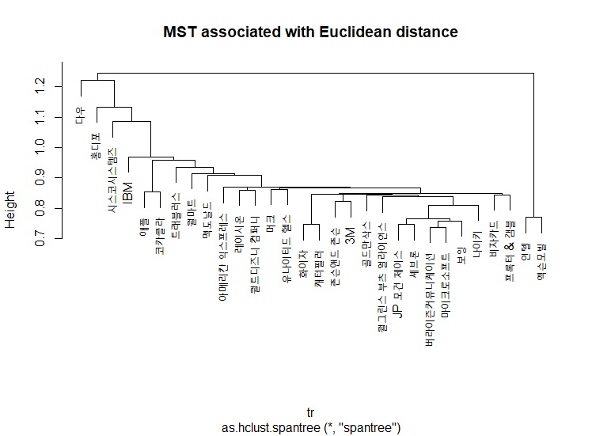
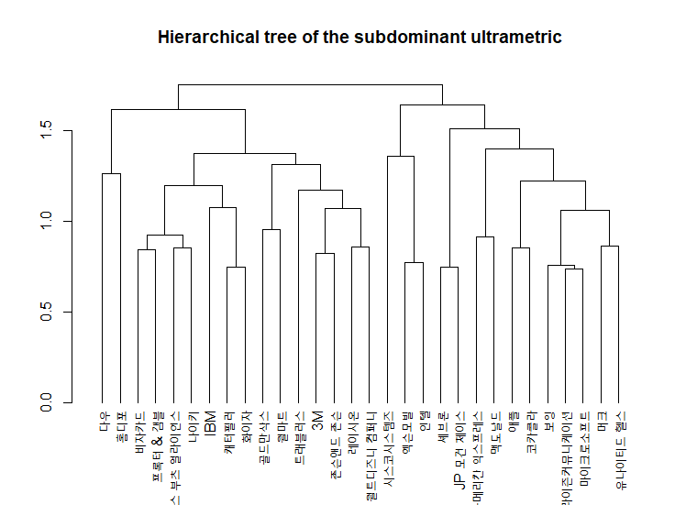
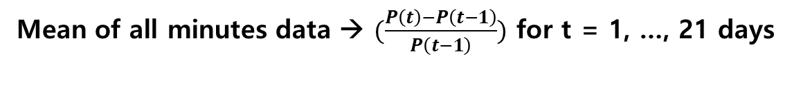
Experiments 3
Mean of all minutes data → $(\frac{P\left(t\right)−P\left(t−1\right)}{P\left(t−1\right)})$ for t = 1, …, 21 days

